Slide 1
NETS 212: Scalable and Cloud Computing
Iterative processing
October 20, 2015
University of Pennsylvania

Slide 2

Announcements
HW3 will be released tomorrow
  MS1 due October 29th at 10:00pm EDT
  MS2 due November 5th at 10:00pm EDT
Emergency office hours after class
Final project: Mini-Facebook application
  Two-person team project, due at the end of the semester
  Specifications will be available soon
  Please start thinking about a potential team member
    Once the spec is out, please send me an email and tell me who is on your team!
    There will be exactly one three-person team, which, in the interest of fairness, must do 50% more work. I will approve the first team that asks. All other teams must have two members.
University of Pennsylvania

Slide 3
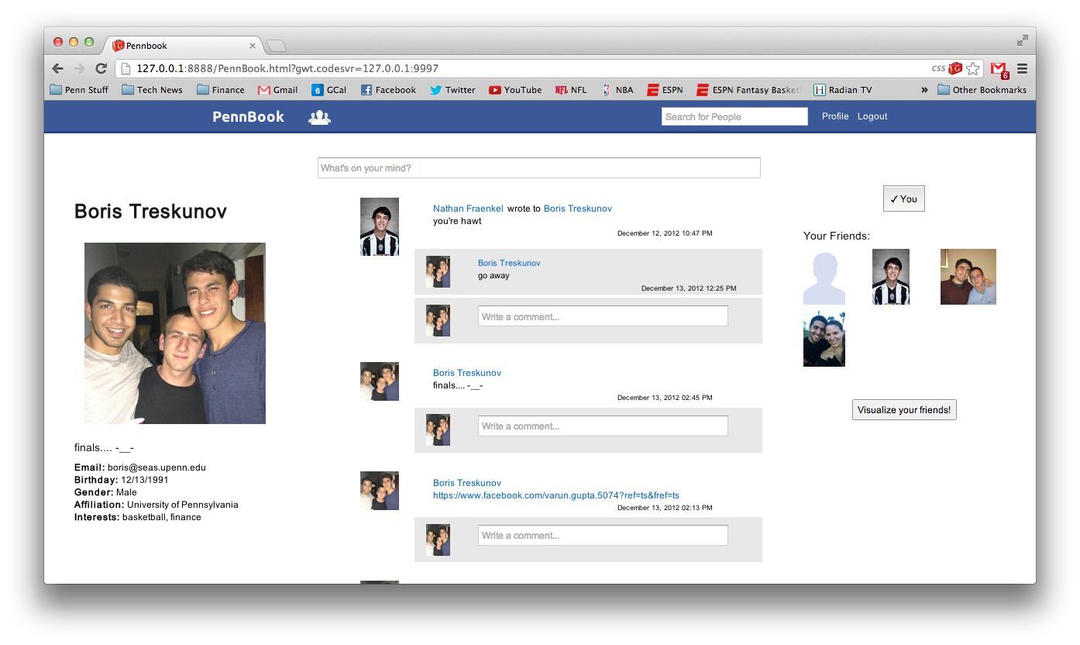
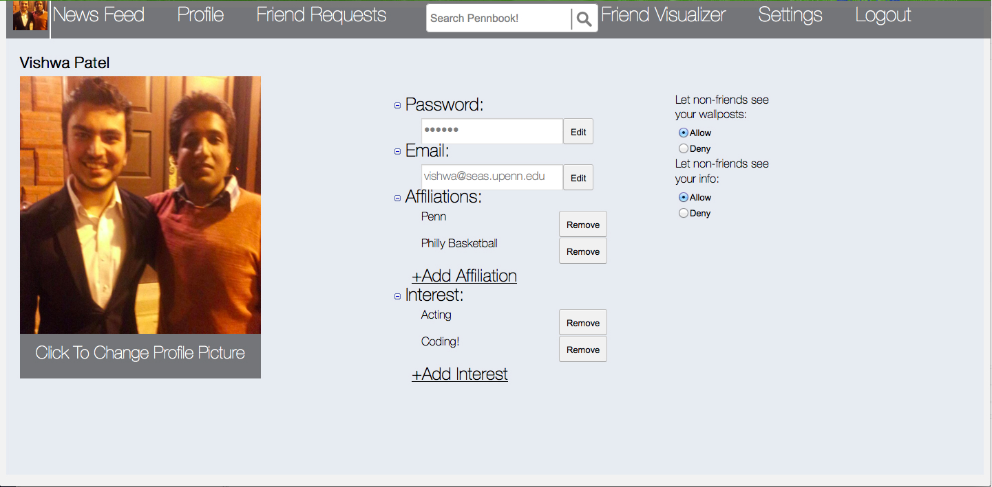
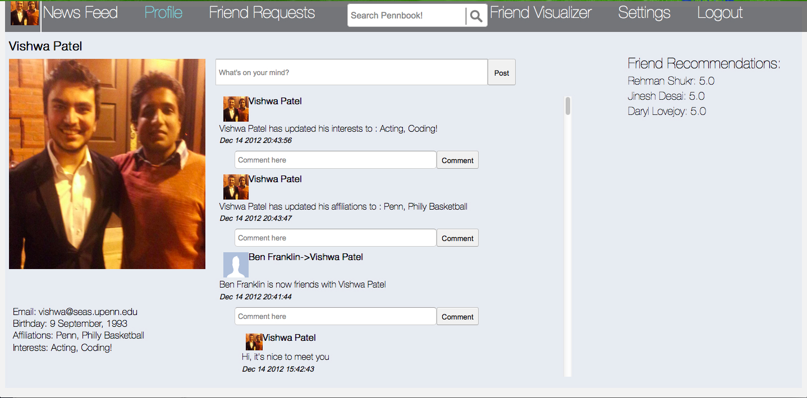
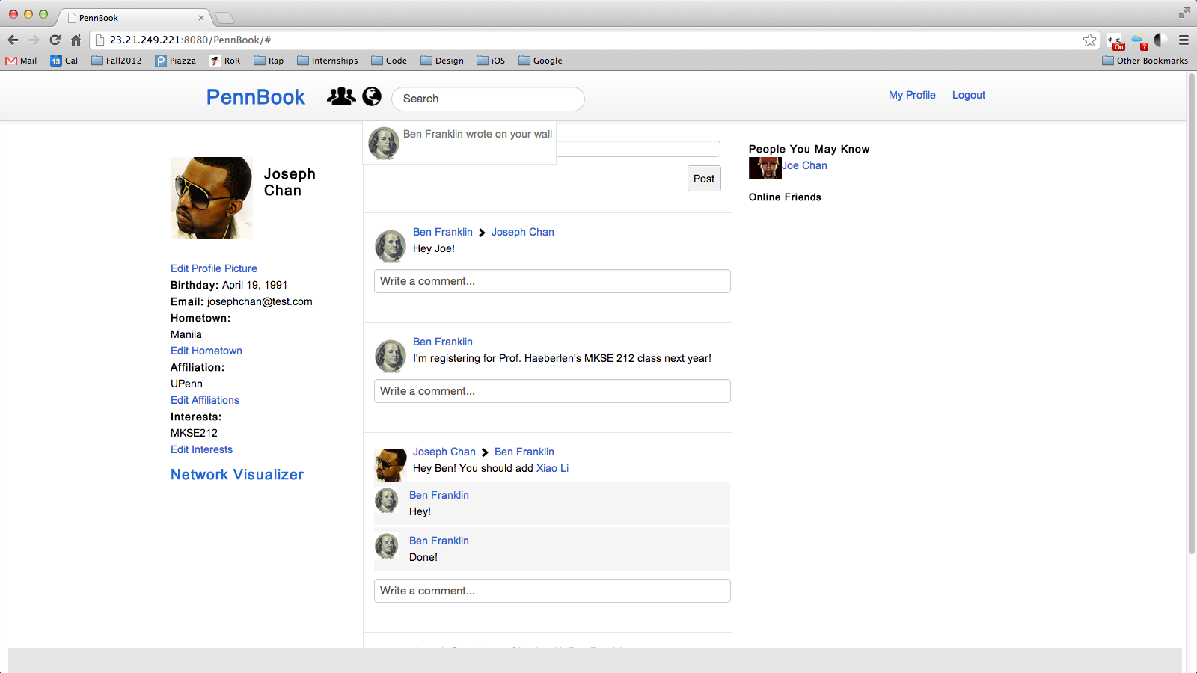
Examples from earlier years
University of Pennsylvania

Slide 4
Some 'lessons learned' from earlier years
The most common mistakes were:
  Started too late; tried to do everything at the last minute
    You need to leave enough time at the end to do debugging etc
  Underestimated amount of integration work
    Suggestion: Define clean interfaces, build dummy components for testing, exchange code early and throughout the project
    Suggestion: Work together from the beginning! (Pair programming?)
  Unbalanced team
    You need to pick your teammate wisely, make sure they pull their weight, keep them motivated, ...
    You and your teammate should have compatible goals
    (Example: Go for the Facebook award vs. get a passing grade)
  Started coding without a design
    FIRST make a plan: what pages will there be? how will the user interact with them? how will the interaction between client and server work? what components will the program have? what tables will there be in the database, and what fields should be in them? etc.
University of Pennsylvania

Slide 5

Facebook award
Facebook is sponsoring an award
for the best final projects
  Backpack or duffle bag for each team member,
  with surprise contents
  Winners will be announced on the course web page
  ("NETS212 Hall of Fame")
    http://www.cis.upenn.edu/~nets212/hall-of-fame.html
University of Pennsylvania

Slide 6
Plan for today
Generalizing the computation model
  Bulk synchronous parallelism (BSP)
Pregel
Spark
NEXT
University of Pennsylvania

Slide 7
Recall: Iterative computation in MapReduce
map
red
map
red
Iterative
comp.
map
red
map
red
Init state,
convert input
into input +
state
Test for
convergence
Discard
state, output
results
MapReduce is functional
  map() and reduce() 'forget' all state between iterations
  Hence, we have no choice but to put the state into the intermediate results
  This is a bit cumbersome
University of Pennsylvania

Slide 8
What if we could remember?
Suppose we were to change things entirely:
  Graph is partitioned across a set of machines
  State is kept entirely in memory
  Computation consists of message passing,
  i.e., sending updates from one portion to another
Let’s look at two versions of this:
  Pregel (Malewicz et al., SIGMOD'10 – Google's version)
  Spark (Zaharia et al., NSDI'12 – UC Berkeley's version)
University of Pennsylvania

Slide 9
Let's think about the MapReduce model
How does MapReduce
process graphs?
  "Think like a vertex"
  What do the vertices do?
  What are the edges, really?
How good a fit is MapReduce's keys → values model for this?
  ... and what are the consequences?
vertex
ID
vertex
ID
vertex value
University of Pennsylvania
Notes:
Edges really are messages
Consequences are low usability and suboptimal performance (see Pregel paper, intro)
Existing graph-parallel systems, before Pregel, didn't address fault tolerance etc. and were thus not suitable for processing at scale. Graph libraries like BGL or GraphBase ran on a single computer and thus limited the scale of problems that could be solved

Slide 10
The BSP model
This is similar to the bulk-synchronous parallelism (BSP) model
  Developed by Leslie Valiant at Harvard during the 1980s
BSP computations consist of:
  Lots of components that process data
  A network for communication, and a way to synchronize
Three distinct phases:
  Concurrent computation
  Communication
  Barrier synchronization
  Repeat
Valiant, "A bridging model for parallel computation", CACM Vol. 33 No. 8, Aug. 1990
...
University of Pennsylvania

Slide 11
Properties of the BSP model
Can BSP computations have:
  Deadlocks?
  Race conditions?
  If so, when? If not, why note?
How well do BSP computations scale? Why?
Are there algorithms for which it cannot
(or should not) be used?
University of Pennsylvania

Slide 12

Plan for today
Generalizing the computation model
  Bulk synchronous parallelism (BSP)
Pregel
Spark
NEXT
University of Pennsylvania

Slide 13
The basic Pregel execution model
A sequence of supersteps, for each vertex:
Receive incoming messages
Compute()
  Update value / state
Send outgoing messages
Optionally change toplogy
Malewicz et al., "Pregel: a system for large-scale graph processing", Proc. ACM SIGMOD 2010
vertex
ID
vertex value’
vertex value
University of Pennsylvania

Slide 14
Pregel: Termination test
Vote to halt
Active
Inactive
Message received
How do we know when the computation is done?
  Vertexes can be active or inactive
  Each vertex can independently vote to halt, transition to inactive
  Incoming messages reactivate the vertex
  Algorithm terminates when all vertexes are inactive
  Examples of when a vertex might vote to halt?
University of Pennsylvania

Slide 15
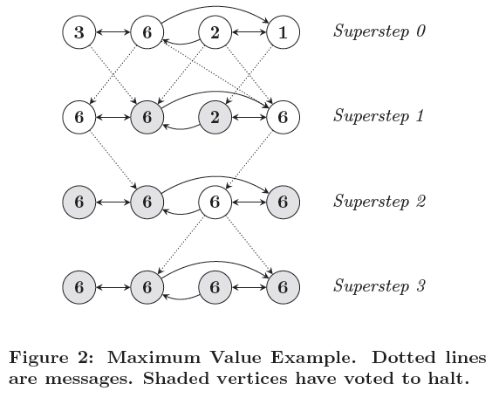
Pregel: A simple example (max value)
University of Pennsylvania

Slide 16
Pregel: Producing output
Output is the set of values explicitly output
by the vertices
  Often a directed graph isomorphic to the input...
  ... but it doesn't have to be (edges can be added or removed)
  Example: Clustering algorithm
What if we need some global statistic instead?
  Example: Number of edges in the graph, average value
  Each vertex can output a value to an aggregator in
  superstep S
  System combines these values using a form of 'reducer',
  and result is available to all vertexes in superstep S+1
  Aggregators need to be commutative and associative (why?)
University of Pennsylvania

Slide 17
Example: PageRank in Pregel
class PageRankVertex : public Vertex<double, void, double> {
public:
virtual void Compute(MessageIterator* msgs) {
if (superstep() >= 1) {
double sum = 0;
for (; !msgs->Done(); msgs->Next())
sum += msgs->Value();
*MutableValue() = 0.15 / NumVertices() + 0.85 * sum;
}
if (superstep() < 30) {
const int64 n = GetOutEdgeIterator().size();
SendMessageToAllNeighbors(GetValue() / n);
} else {
VoteToHalt();
}
}
};
University of Pennsylvania

Slide 18
Pregel: Additional complications
How to coordinate?
  Basic Master/worker design (just like MapReduce)
How to achieve fault tolerance?
  Crucial!! Why?
  Failures detected via heartbeats (just like in MapReduce)
  Uses checkpointing and recovery
  Basic checkpointing vs. confined recovery
How to partition the graph among the workers?
  Very tricky problem!
  Addressed in much more detail in later work
University of Pennsylvania

Slide 19
Summary: Pregel
Bulk Syncronous Parallelism – sequence of synchronized supersteps
Consider the nodes to have state (memory) that carries from superstep to superstep
Connections to MapReduce model?
University of Pennsylvania

Slide 20
Plan for today
Generalizing the computation model
  Bulk synchronous parallelism (BSP)
Pregel
Spark
NEXT
University of Pennsylvania

Slide 21
Another Abstraction: Spark
Let’s think of just having a big block of RAM, partitioned across machines…
  And a series of operators that can be executed in parallel across the different partitions
That’s basically Spark's resilient distributed datasets (RDDs)
  Spark programs are written by defining functions to be called over items within collections
  (similar model to LINQ, FlumeJava, Apache Crunch, and several other environments)
Zaharia et al., "Resilient Distributed Datasets: A Fault-Tolerant Abstraction for In-Memory Cluster Computing", Proc. NSDI 2012
University of Pennsylvania

Slide 22
Spark: Transformations and actions
RDDs are read-only, partitioned collections
Programmer starts by defining a new RDD based on data in stable storage
  Example: lines = spark.textFile("hdfs://foo/bar");
Programmer can create more RDDs by applying transformations to existing ones
  Example: errors = lines.filter(_.startsWith("ERROR"));
Only when an action is performed does Spark do actual work:
  Example: errors.count()
  Example: errors.filter(_contains("HDFS")).
  map(_split("\t")(3)).collect()
University of Pennsylvania

Slide 23
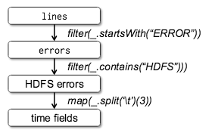
Spark: Lineage
Spark keeps track of
how RDDs have been
constructed
  Result is a lineage graph
  Vertexes represent RDDSs,
  edges represent transformations
What could this be useful for?
  Fault tolerance: When a machine fails, the corresponding piece of the RDD can be recomputed efficiently
    How would a multi-stage MapReduce program achieve this?
  Efficiency: Not all RDDs have to be 'materialized' (i.e., kept in RAM as a full copy)
University of Pennsylvania

Slide 24
Spark: A closer look at transformations
In Spark, we treat RDDs as another kind of parametrized collection
  JavaRDD represents a partitioned set of items
  JavaPairRDD represents a partitioned set of keys/values
We can perform operations like:
myFilterFn is an object that implements a callback, which is invoked for each element
  Receives an element as an argument; returns a boolean
  newRdd includes only elements for which this was 'true'
  Does this remind you of anything?
  JavaRDD<String> myRdd = context.textFile(“myFile”, 1);
  newRdd = myRdd.filter(myFilterFn);
University of Pennsylvania

Slide 25
Spark: Another example callback
  JavaPairRDD<String,String> derivedRdd = myRdd.mapToPair(
  new PairFunction<String, String, String>() {
  @Override public Tuple2<String, String> call(String s) {
  String[] parts = s.split(“ “);
  return new Tuple2<String, String>(parts[0], parts[1]);
  }
  }
  );
Original RDD contains Strings
Callback transforms each String to a (String,String) tuple
  PairFunction<T,K,V> takes a T and returns a (K,V)
New RDD contains pairs of strings
University of Pennsylvania

Slide 26
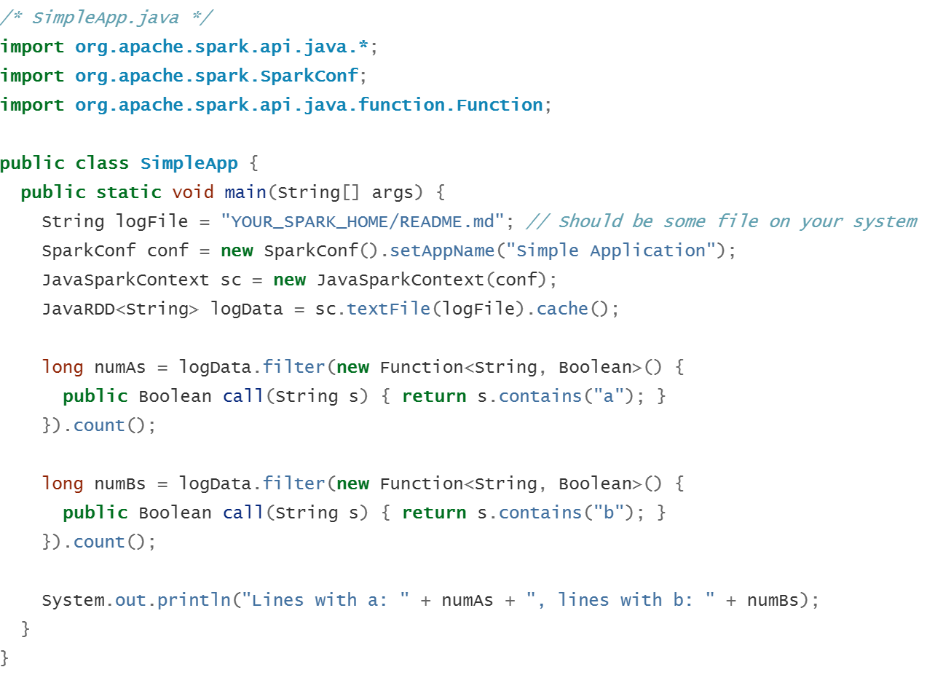
Example Spark WordCount in Java
University of Pennsylvania

Slide 27
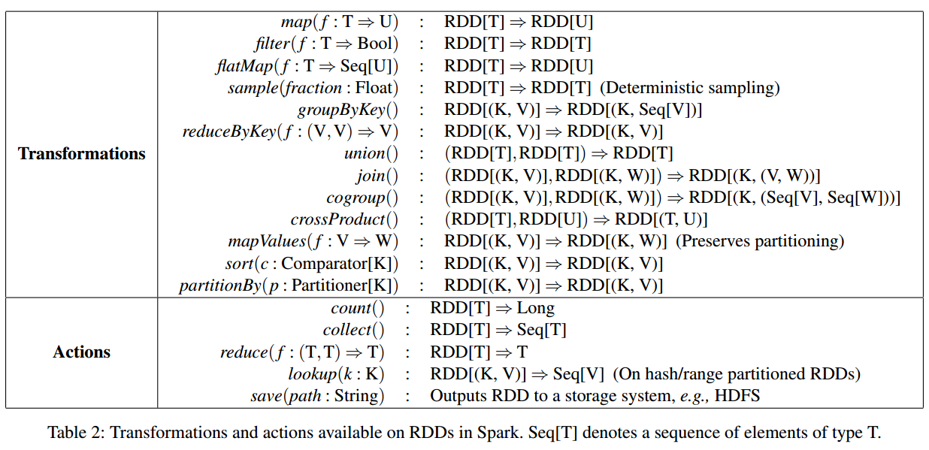
Parallel Operations in Spark
Lazy operations
that define new
RDDs based on
existing ones
Acually launch
computations
University of Pennsylvania

Slide 28
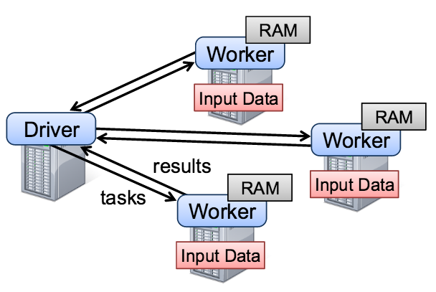
Spark: Implementation
Developer writes a driver program that connects to a cluster of workers
  Driver defines RDDs, invokes actions, tracks lineage
  Workers are long-lived processes that store pieces of RDDs in memory and perform computations on them
  Many of the details will sound familiar: Scheduling, fault detection and recovery, handling stragglers, etc.
University of Pennsylvania

Slide 29
What can you do easily in Spark?
Global aggregate computations that produce program state – compute the count() of an RDD, compute the max diff, etc.
Loops!
Built-in abstractions for some other common operations like joins
See also Apache Crunch / Google FlumeJava for a very similar approach
University of Pennsylvania

Slide 30
What else might we want to do?
Spark makes it much easier to do multi-stage MapReduce
Later we will see a series of higher-level languages that support optimization, where alternative implementations are explored…
  Hybrid languages (Pig Latin)
  Database languages (Dremel, Hive, Shark, Hyrax, …)
University of Pennsylvania

Slide 31

Stay tuned
Next time you will learn about:
Web programming
University of Pennsylvania

Slide 32
Spark: Example (PageRank)
// Load graph as an RDD of (URL, outlinks) pairs
val links = spark.textFile(...).map(...).persist()
var ranks = // RDD of (URL, rank) pairs
for (i <- 1 to ITERATIONS) {
// Build an RDD of (targetURL, float) pairs
// with the contributions sent by each page
val contribs = links.join(ranks).flatMap {
(url, (links, rank)) =>
links.map(dest => (dest, rank/links.size))
}
// Sum contributions by URL and get new ranks
ranks = contribs.reduceByKey((x,y) => x+y)
.mapValues(sum => a/N + (1-a)*sum)
}
Foo
University of Pennsylvania

Slide 33

Backup slides
Here be dragons
University of Pennsylvania

